Slide 1


Dr V Padmaja
MBBS: Kakatiya medical college , wgl :1985
MD : obg : AIIMS : 1992-1994
Assistant prof psg medical college : 1995
Worked in `Wgl : 1996, 1997
In Vijayawada : from 1998
Ex secretary : VOGS
Executive member : VOGS

Slide 2


Slide 3

Unexplained infertility – IVF Vs IUI
Dr.V.Padmaja
Padmaja Clinic, Vijayawada
Padmaja.clinic@gmail.com

Slide 4

Unexplained infertility
Is a subject on which agreement is rarely found among practitioners

Slide 5
UI
Standard investigations:
Including semen analysis,
tests of ovulation
and
tubal patency have failed to detect any gross abnormality
(Crosignani et al., 1993).

Slide 6

. UI 30–40% of couples (Smith et al., 2003)

Slide 7
COS and IUI
The combination of has gained acceptance as a treatment for ui.
The rationale of this approach is based on the assumption that the likelihood of conception will increase if multiple fertilizable oocytes can be recruited in a treatment cycle and if the motile spermatozoa can be introduced directly into the uterine cavity to bypass the cervical mucus barrier and be placed closer to the oocytes (Allen et al., 1985).

Slide 8
The main advantages of IUI over IVF are its simplicity and relative inexpensiveness
However, there are many advantages of IVF over IUI – principally those of a higher pregnancy rate, the ability to avoid multiple pregnancies by transferring a single embryo and cryopreserving any spare embryos generated in the IVF cycle, and the knowledge gained about the ability of the sperm to fertilize the oocytes

Slide 9

Pregnancy rates in COH-IUI cycles are approximately half those of IVF cycles for patients of the same age.

Slide 10


Slide 11



Slide 12
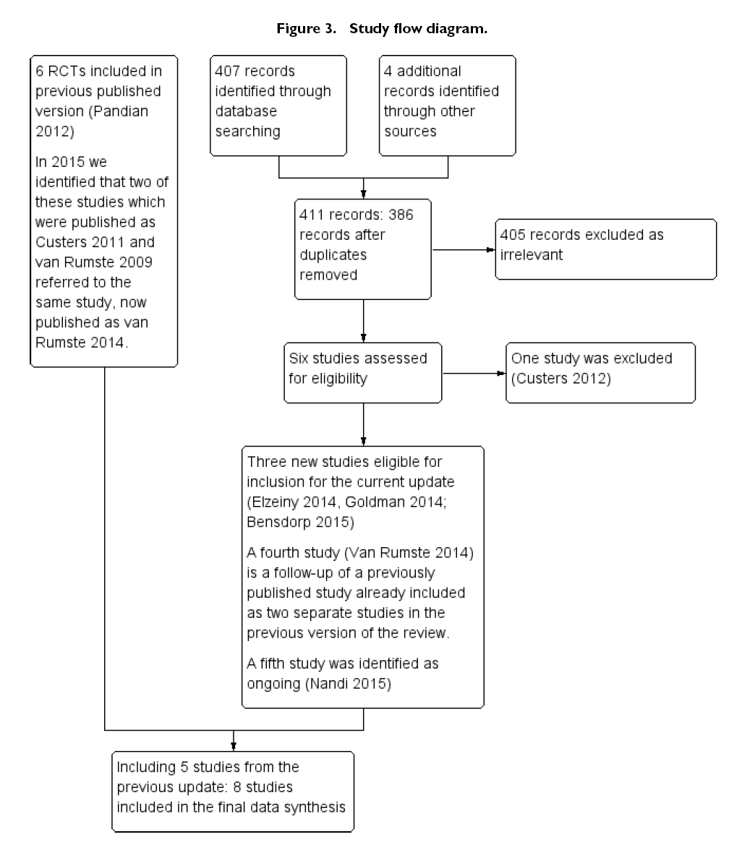

Slide 13
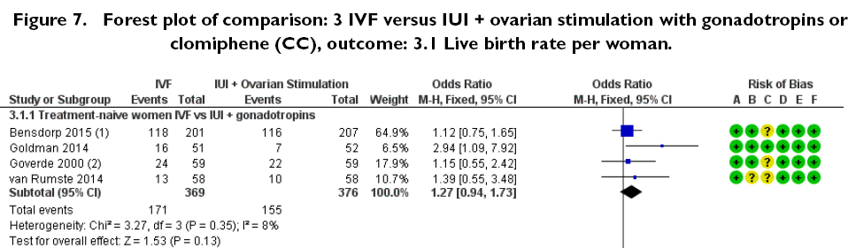


moderate-quality evidence
Evidence was of moderate quality

Slide 14
Evidence was of moderate quality

Slide 15

Evidence was of low quality

Slide 16
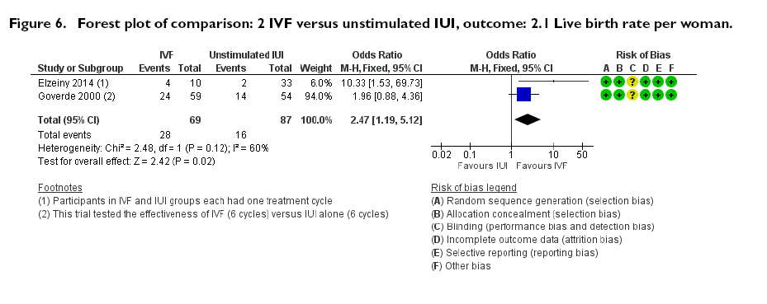
Evidence was of low quality
Notes:
One trial compared the effectiveness of IVF (six cycles) versus
unstimulated IUI (six cycles) (Goverde 2000). The second trial
compared the effectiveness of one cycle of IVF versus one cycle of
unstimulated IUI (Elzeiny 2014).
2.1 Live birth rate (LBR)
IVF was associated with a higher live birth rate than IUI (OR
2.47, 95% CI 1.19 to 5.12, two RCTs, 156 women, I2 = 60%)
(Analysis 2.1; Figure 6). The quality of evidence was deemed to
be low.

Slide 17

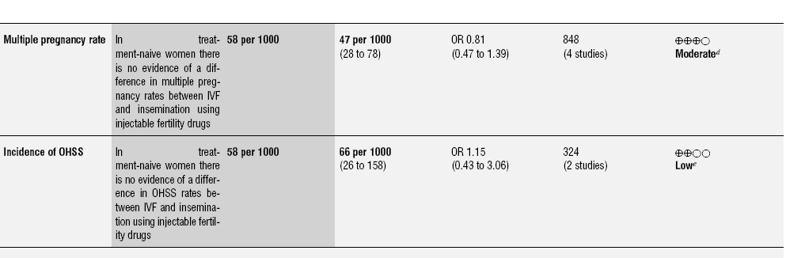

Slide 18
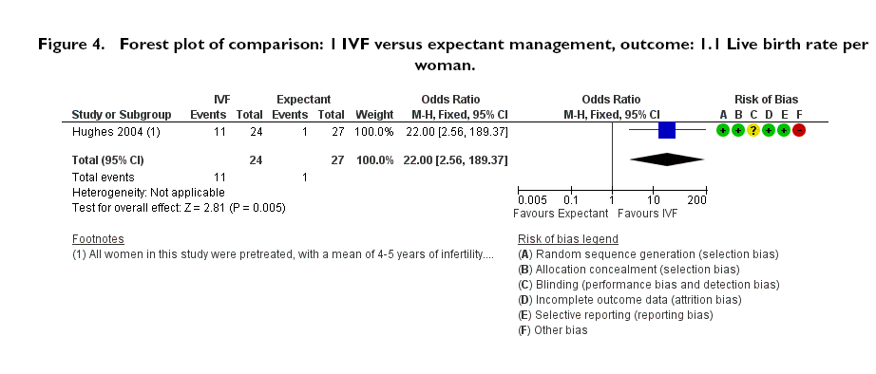
single cycle of IVF was significantly
higher than with three months of expectant management
quality of evidence was deemed
to be very low.
Notes:
LBR per woman or couple with a single cycle of IVF was significantly
higher than with three months of expectant management
(odds ratio (OR) 22.0, 95% confidence interval (CI) 2.56
to 189.38, 51 women). This was tested in a single trial (Hughes
2004) (Analysis 1.1; Figure 4).The quality of evidence was deemed
to be very low.

Slide 19


Slide 20


Slide 21

The availability of resources, the age of the patient and the duration of the infertility all need to be considered while planning the treatment policy with available best evidence.

Slide 22
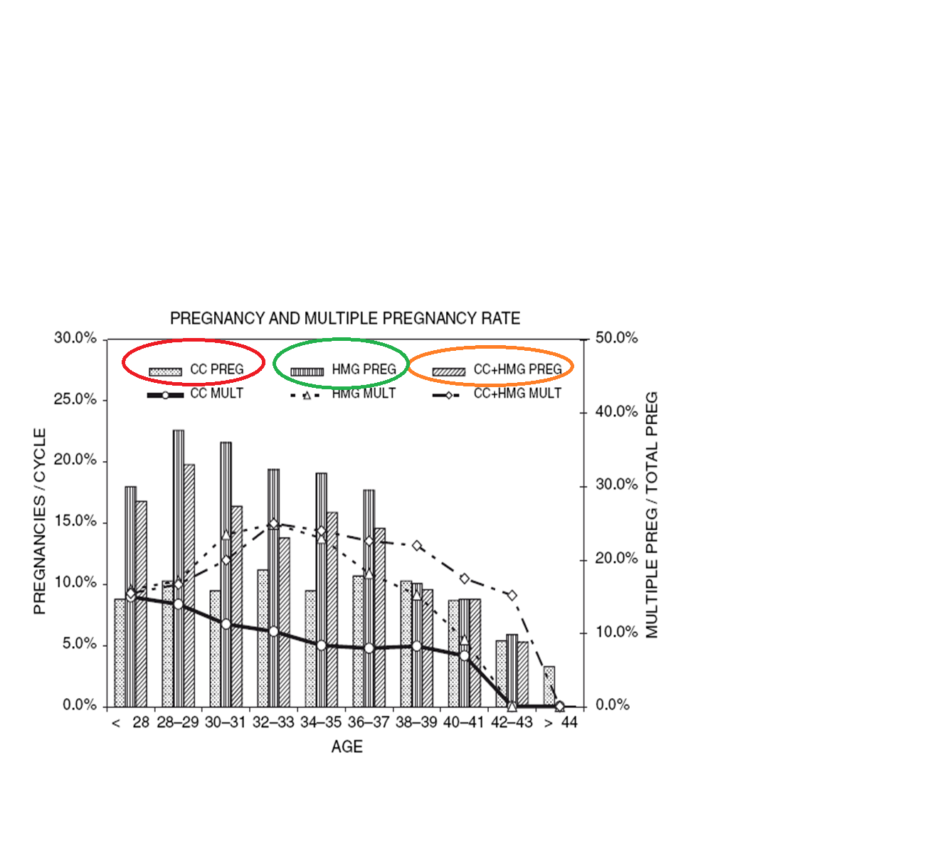
Notes:
Dicket at al 2002

Slide 23
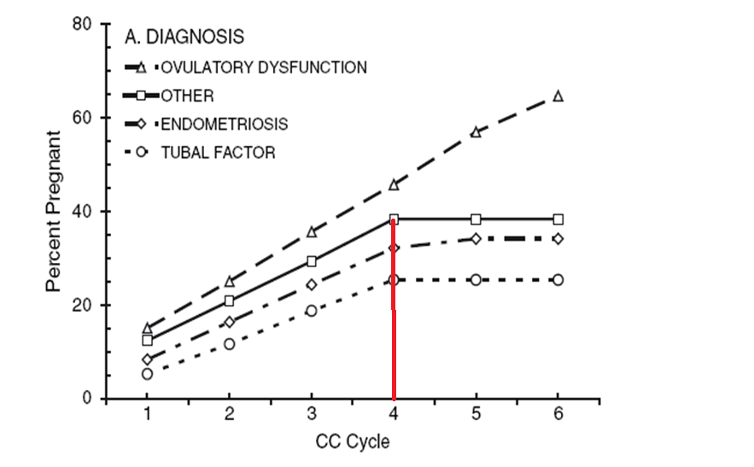
Dickey et al. 2002

Slide 24
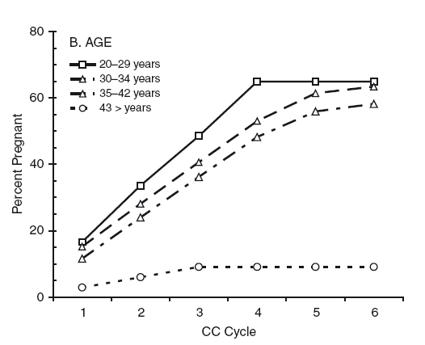

Slide 25
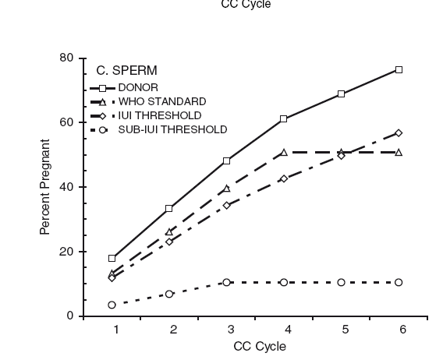
iui threshold : initial sperm quality less than who criteria : but >5m/ml total motile sperms and >30 % initial motility
sub threshold : initial motile sperms <5m/ml or motility <30 %

Slide 26
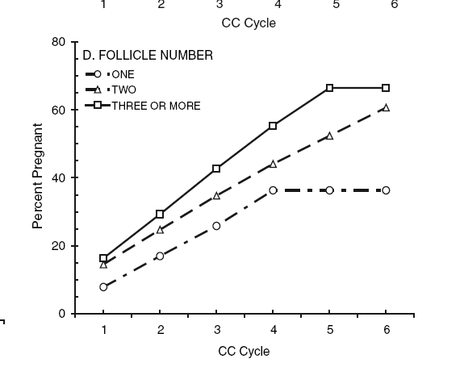
Notes:
Dickey RP, Taylor SN, Lu PY, Sartor BM, Pyrzak R.
Clomiphene citrate intrauterine insemination (IUI)
before gonadotropin IUI affects the pregnancy rate and
high order multiple pregnancy. Fertil Steril 2004; 81:
545–50.

Slide 27
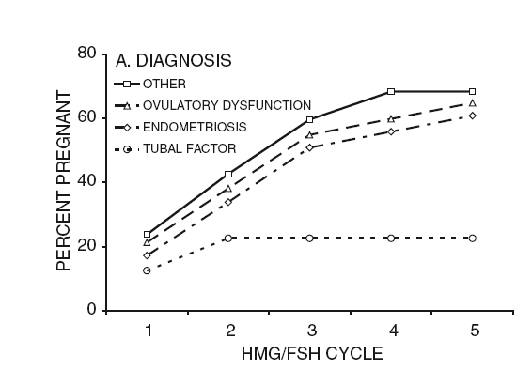
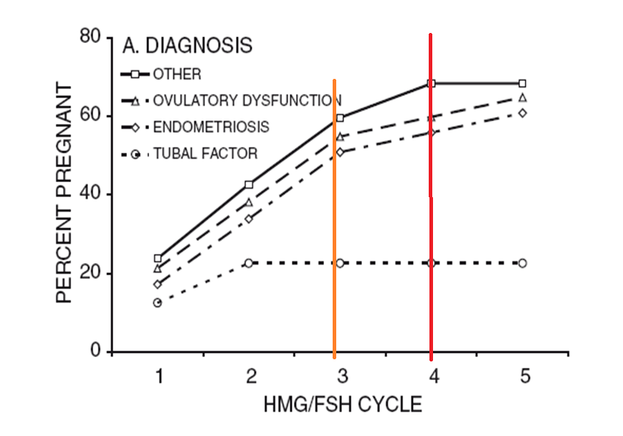

Slide 28
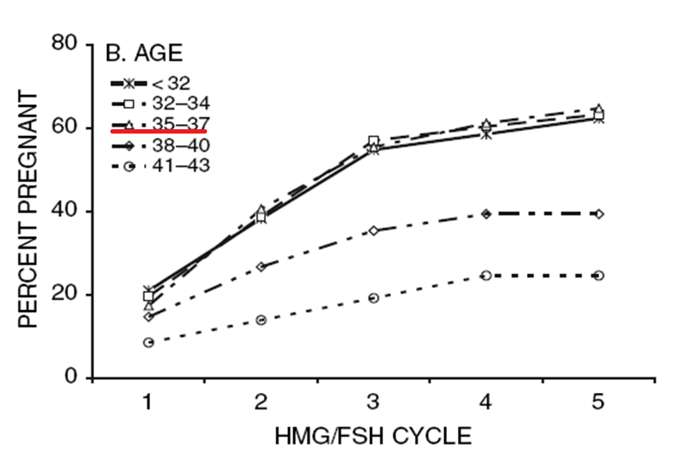
Dickey et al. 2005

Slide 29
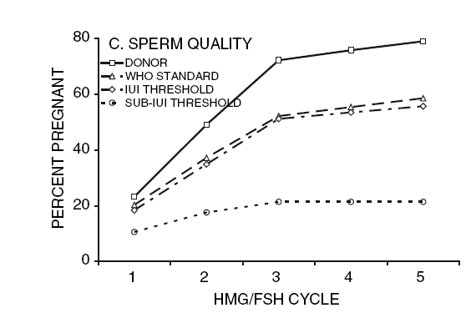
iui threshold : initial sperm quality less than who citreia : but >5m/ml total motile sperms and >30 % inital motility
sub threshold : initial motile sperms <5m/ml or motility <30 %
iui threshold : initial sperm quality less than who citeria : but >5m/ml total motile sperms and >30 % initial motility
sub threshold : initial motile sperms <5m/ml or motility <30 %

Slide 30
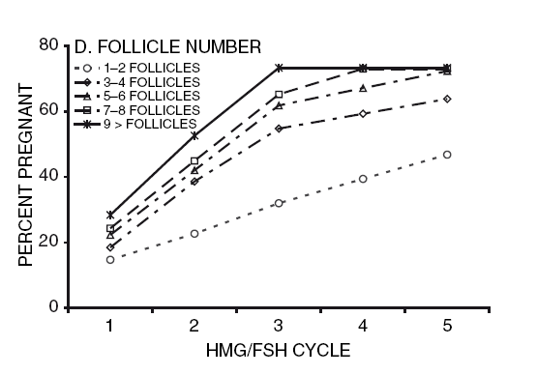

Slide 31
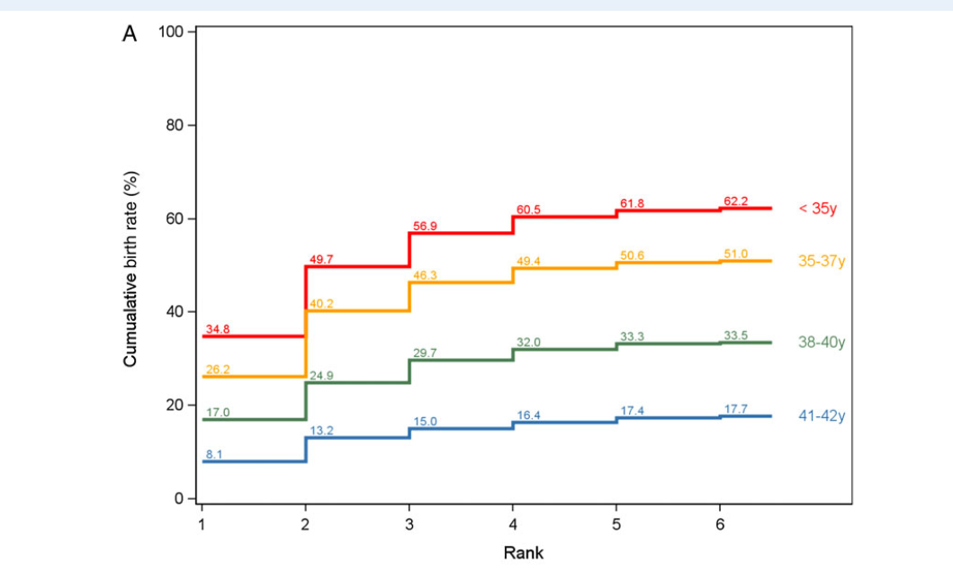
Hefa :Human Fertilisation
Embryology Authority: ivf data

Slide 32
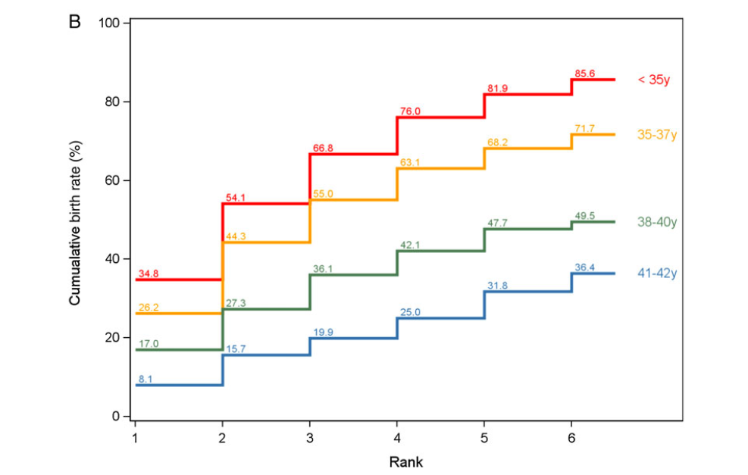
Notes:
Human Reproduction, Vol.31, No.1 pp. 93–99, 2016
D.DeNeubourg1,*, K.Bogaerts2, C.Blockeel3,T.Coetsier4, A.Delvigne5,
F. Devreker6, M. Dubois7, N. Gillain8, S. Gordts9, and C.Wyns10

Slide 33
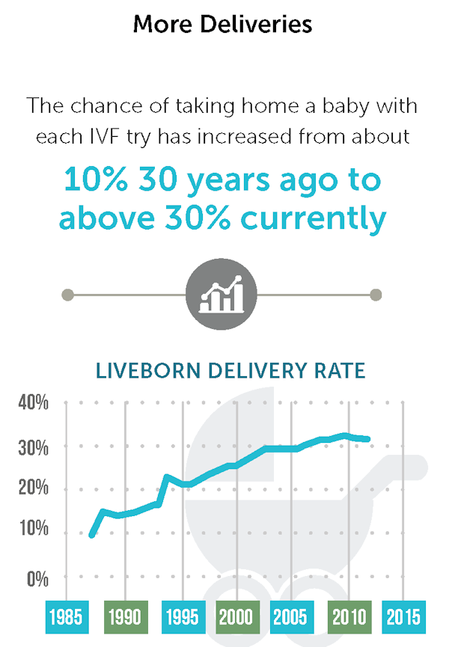
SART DATA
Society for Assisted Reproductive Technology Registry

Slide 34
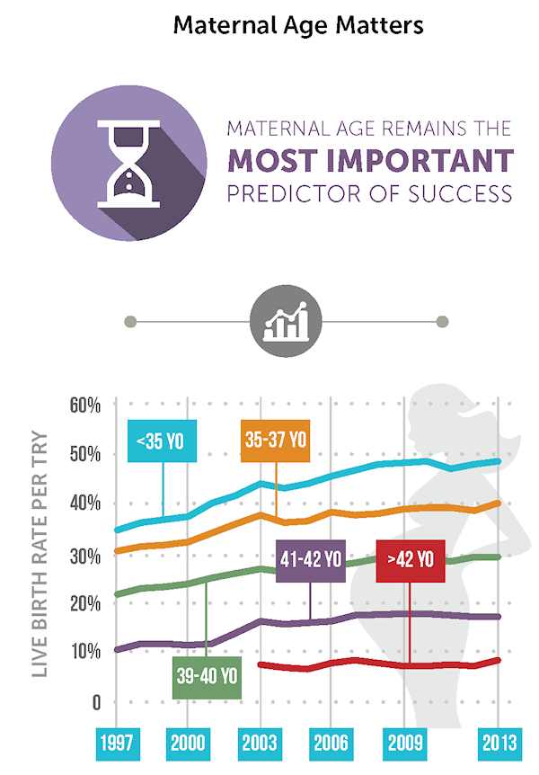

Slide 35

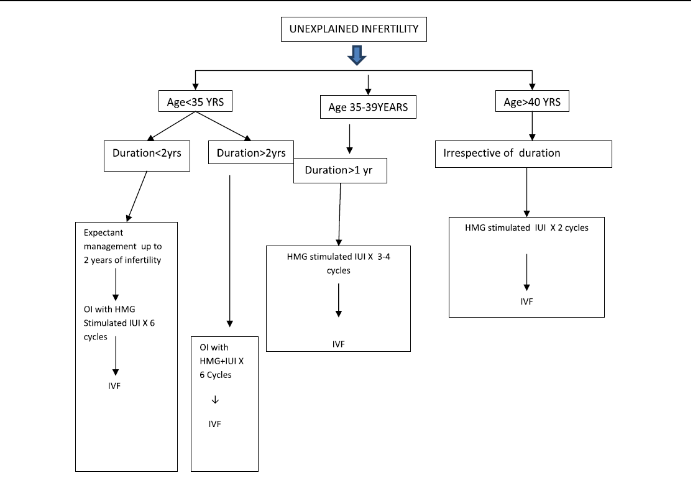

Slide 36
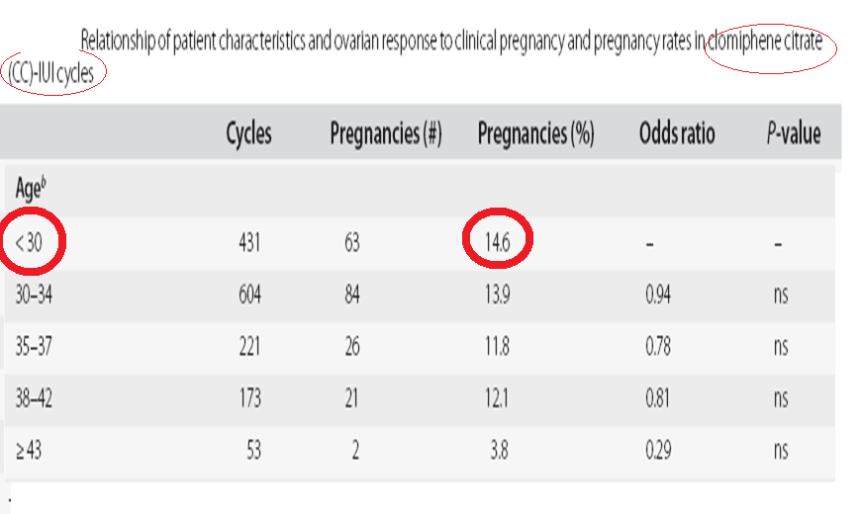

Slide 37
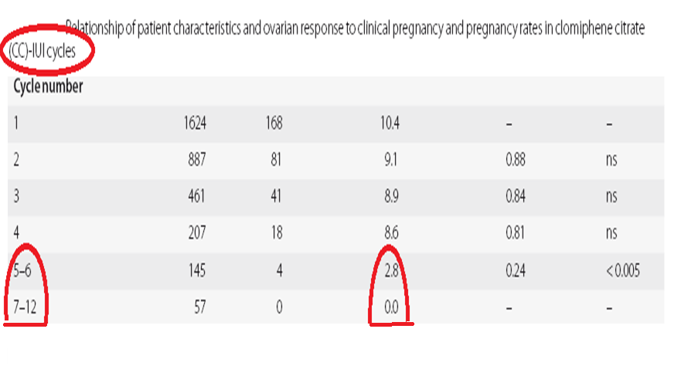

Slide 38
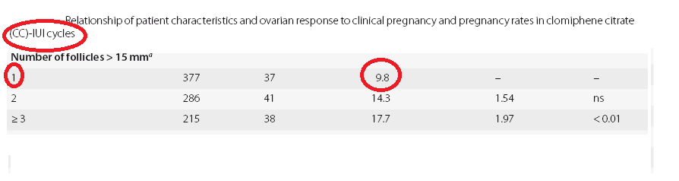

Slide 39
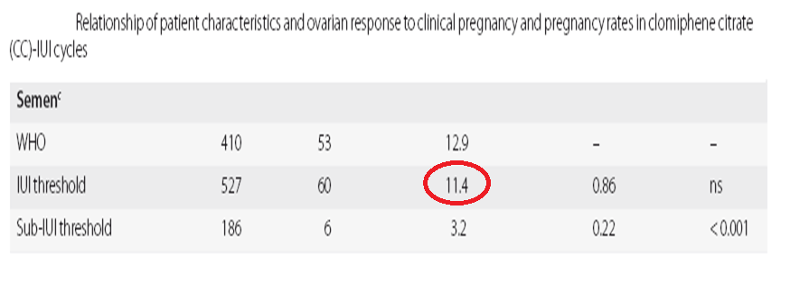

Slide 40
Each additional month of infertility beyond the average reduces the chance of pregnancy by 2%, or about 25%/year.
Similarly, for each year of the female partner’s age >30, the pregnancy rate is reduced by 9%.

Slide 41

Young couple with reasonable male factor , short ml can be given a trial of gn + iui : for 3 cycles in unexplained infertility before recommending ivf , taking into consideration the couples preferences .

Slide 42
There is need for multicentre randomized controlled trials for different modalities of treatment in unexplained infertility.

Slide 43


